Slide 1
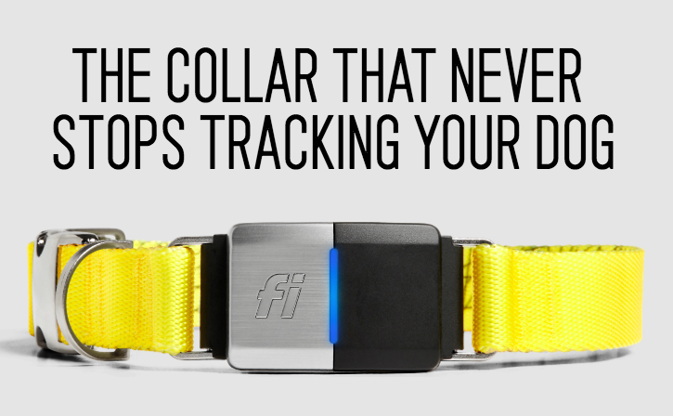
Dog Collar: Fi
Machine Learning Project Example:
Launching a Pet Product in Mx

Slide 2

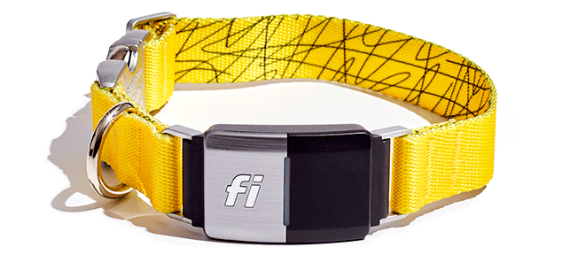
Machine Learning Case Study Assignment
Context and Introduction
Our client is Fi, a world leader in next-generation pet care devices and IoT technology.
Fi envisions a world where pet owners have the ability to take care of their pet like never before. Using their smart collars, pet parents can monitor where their pet is (tracking and remote observation), interact with them virtually, and even look at their health and sleep patterns.
It is next generation 24/7 care for pets, enabled by AI technology.
Case Study: Fi now wants to expand this pet-collar across the US. They need your help in determining what features are important to include, which countries to launch in, and the core trends in next-generation pet care.

Slide 3
Outline
Executive Summary
Introduction
Methodology
Results
Conclusion
Appendix

Slide 4

Executive Summary
Summary of methodologies
Data Collection
Data Wrangling: NLP
Machine Learning: Sentiment Analysis
Viz with Py for Sentiment Analysis Interpretation
Interactive Dashboard
Summary of Analysis
Why Collar Fi is a good option in Mexico
Market Justifications
Conclussions

Slide 5
Introduction
The main objective for this project is to be able to determine market situation and some analysis for a new product. In this case the Fi Dog Smart Collar.
We’ll be using Natural Language Processing Techniques for some Basic Treatments and a BERT base model for Sentiment Analysis of Amazon Reviews.
This reviews will be scraped out of Amazon.com.mx using BeautifulSoup and Selenium

Slide 6
Methodology
Section 1

Slide 7
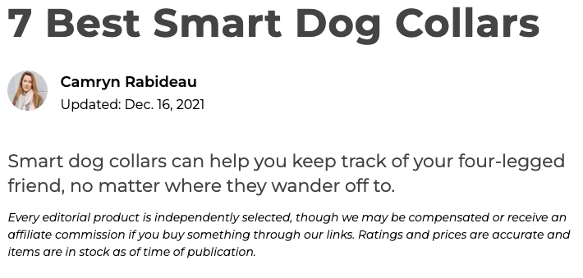
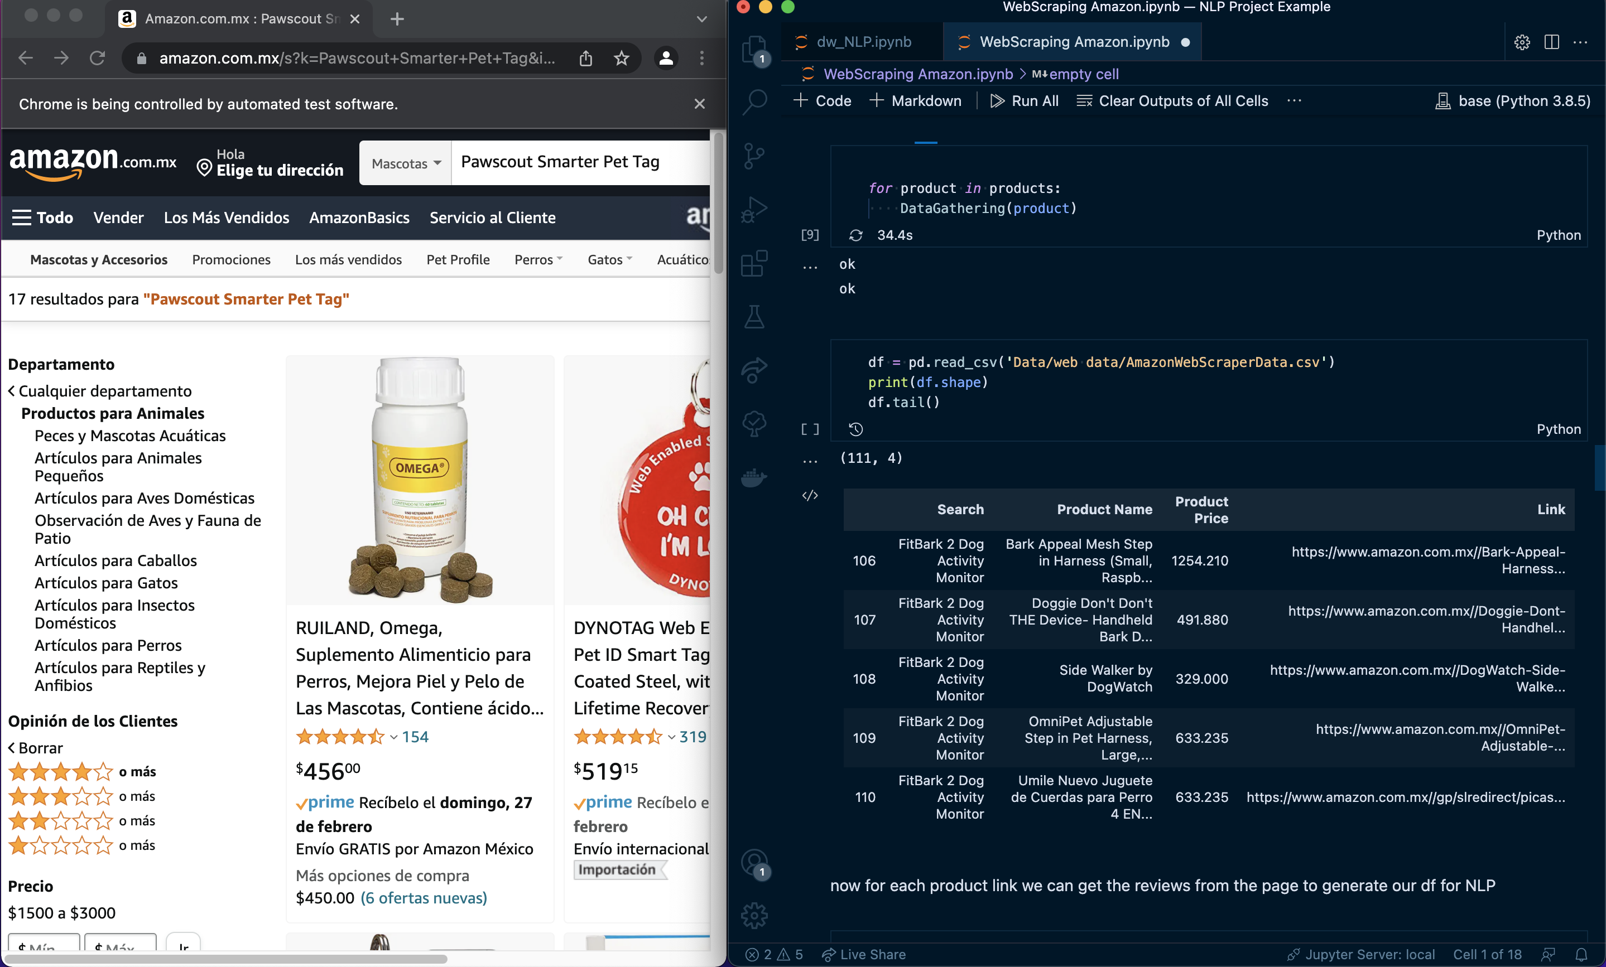
Data Collection – Web Scraping
1
-Read the Article using BeautifulSoup and Slenium libraries
-Get the products from the market study
-Using the global leader amazon ecommerce we will look up for them and gather info on al searches
-Save into a CSV for later analysis
2
GET prods from Article
GET Searches on Article
3
Get Review for every seacrh

Slide 8

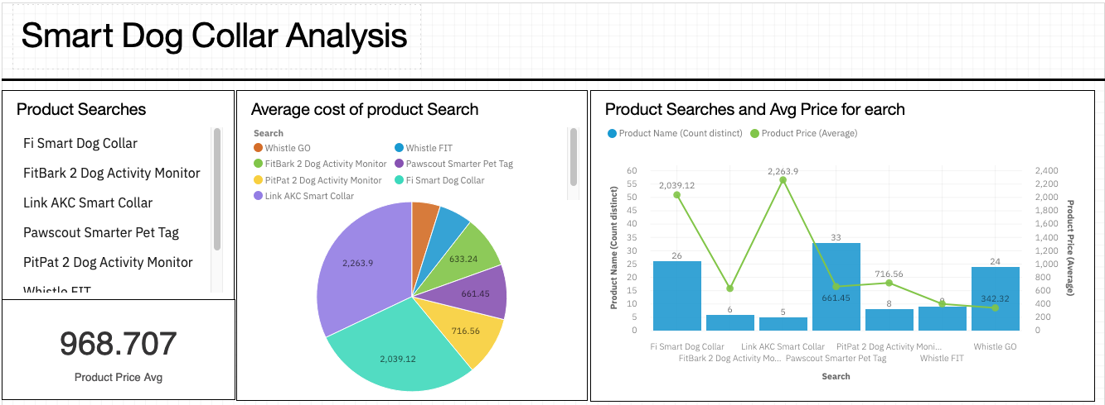
Data Analysis from scraping

Slide 9
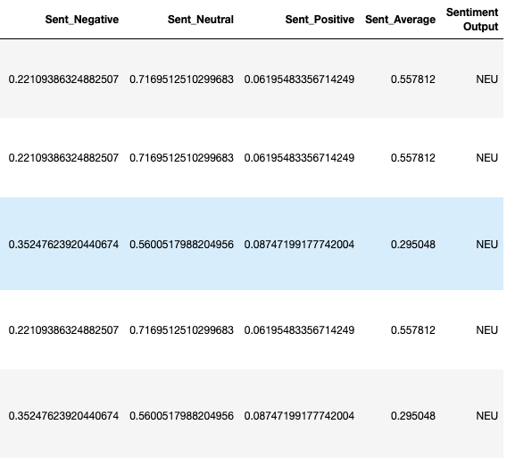
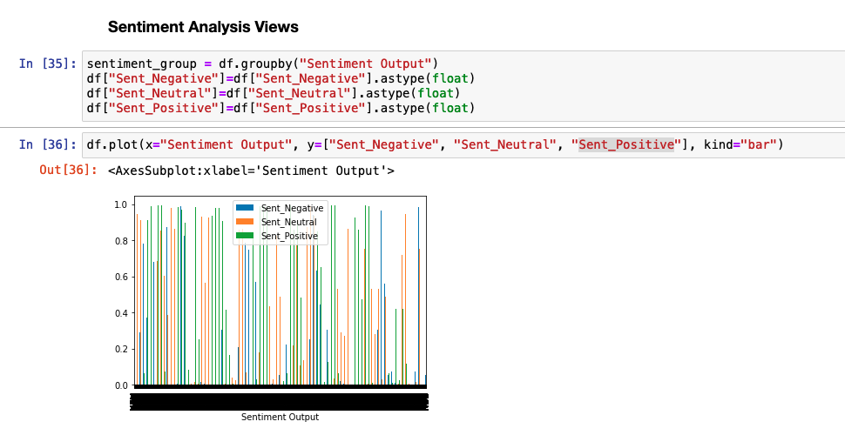
ML: NLP & Sentiment Analysis
Based on BERT model we generate a Sentiment Analysis on each review to know users experience with each individual product

Slide 10
Market Study

Slide 11
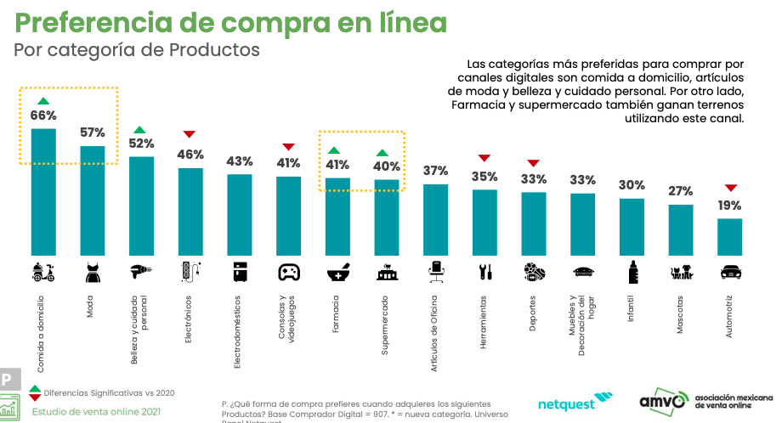

Slide 12
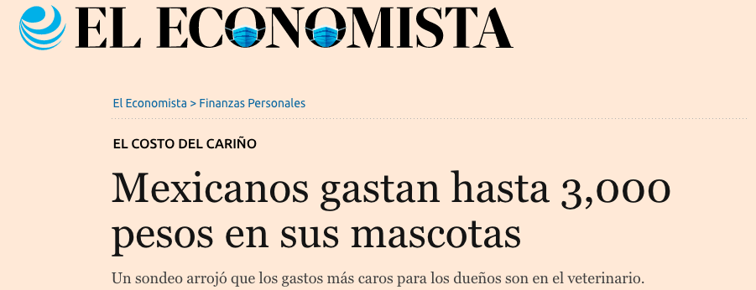
https://www.eleconomista.com.mx/finanzaspersonales/Mexicanos-gastan-hasta-3000-pesos-en-sus-mascotas-20200301-0042.html

Slide 13
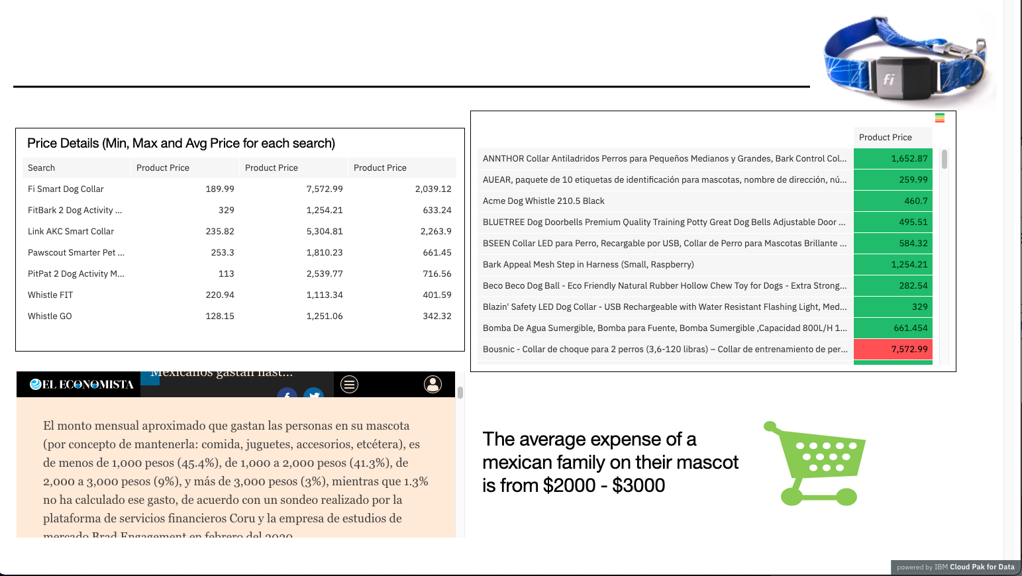
Data Analysis price according to Market Study

Slide 14
Conclusion
Dog Collar Fi are an excellent option according to what customers are looking forward when they want to buy a Smart Dog Collar.
According to market study the price is in place for Mexican market according to INEGI data on how much Mexican expend in their mascots per month.

